Slide 1

EC2 – AWS Solution Architect Session 1
By Mohamed Rizk (Senior Cloud Network Architect)

Slide 2
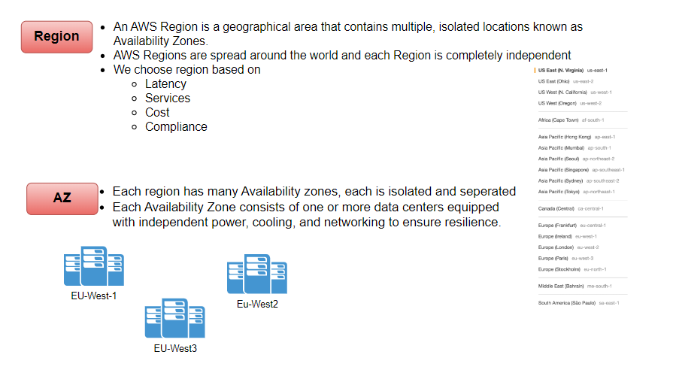

Slide 3
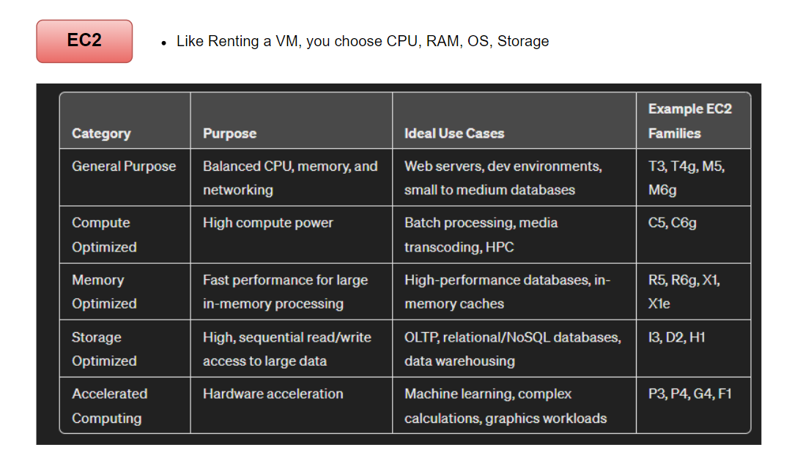

Slide 4
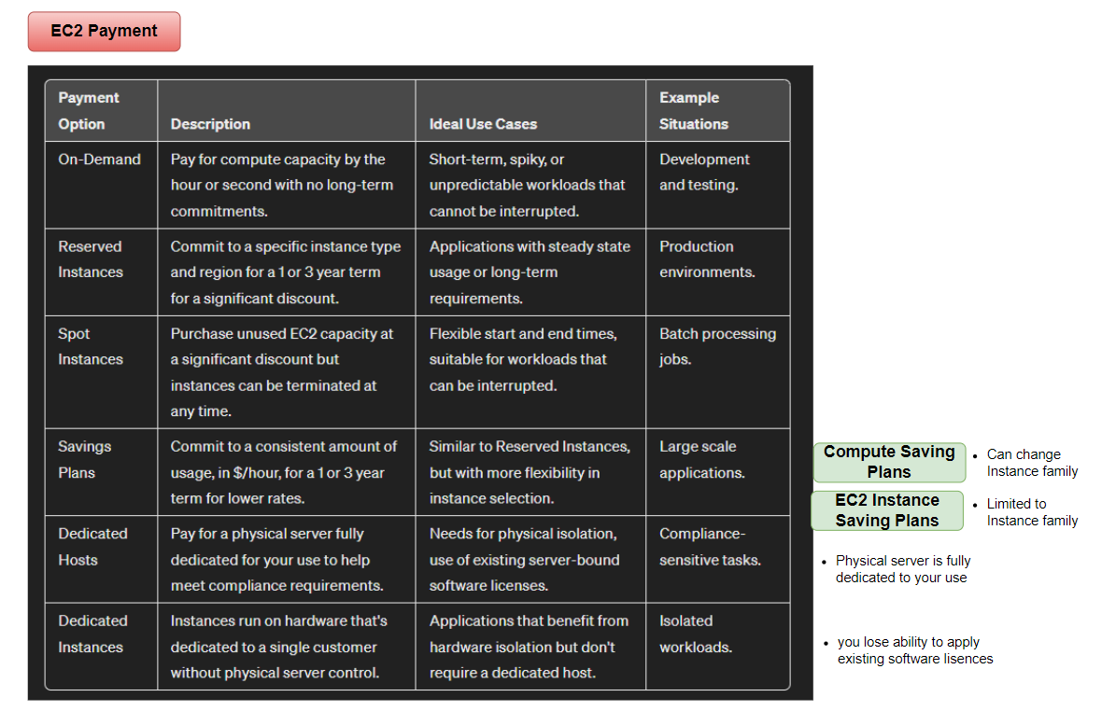

Slide 5
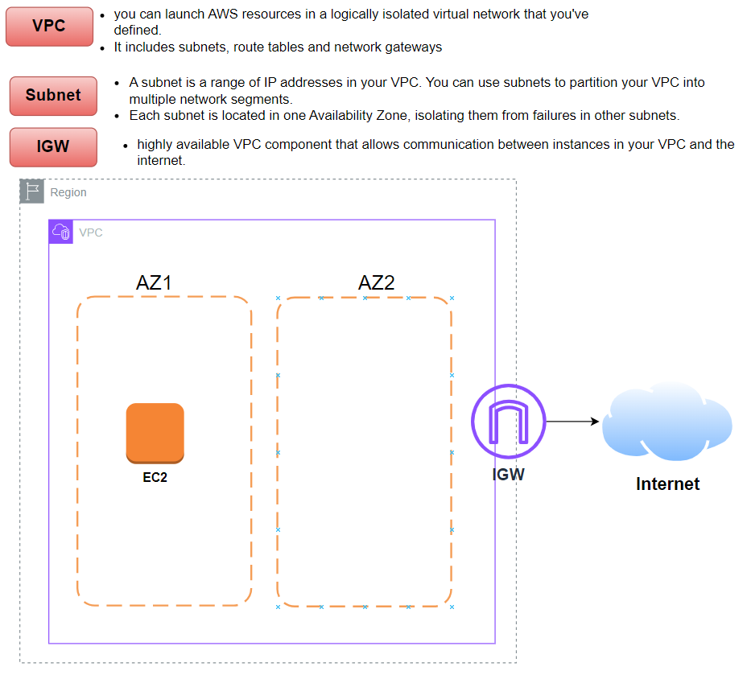

Slide 6
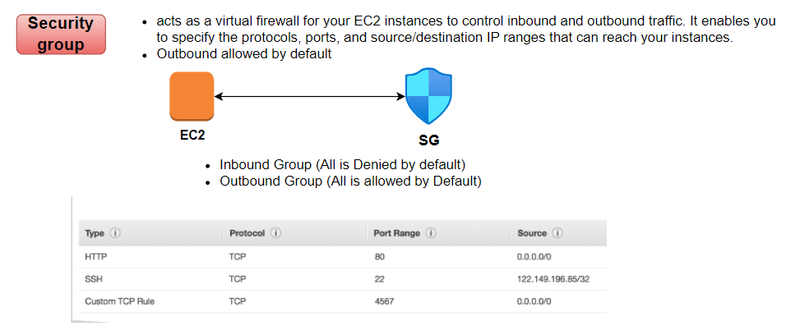
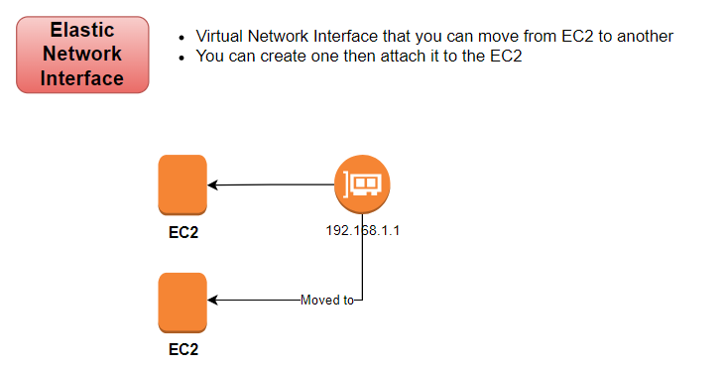

Slide 7
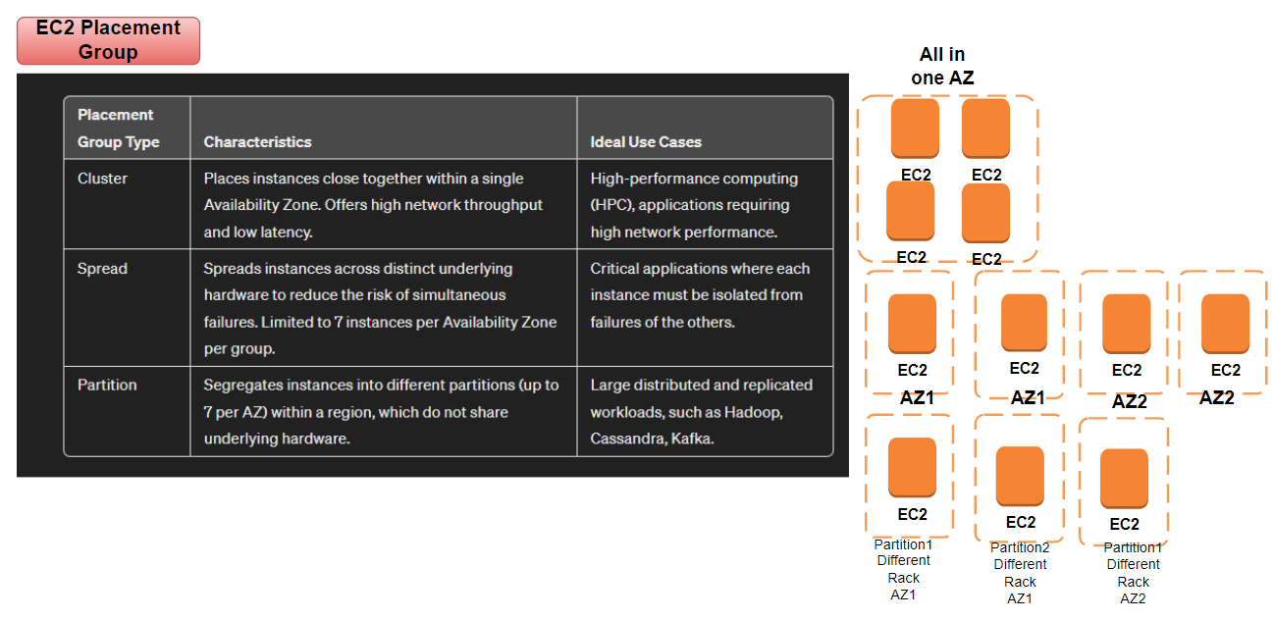

Slide 8
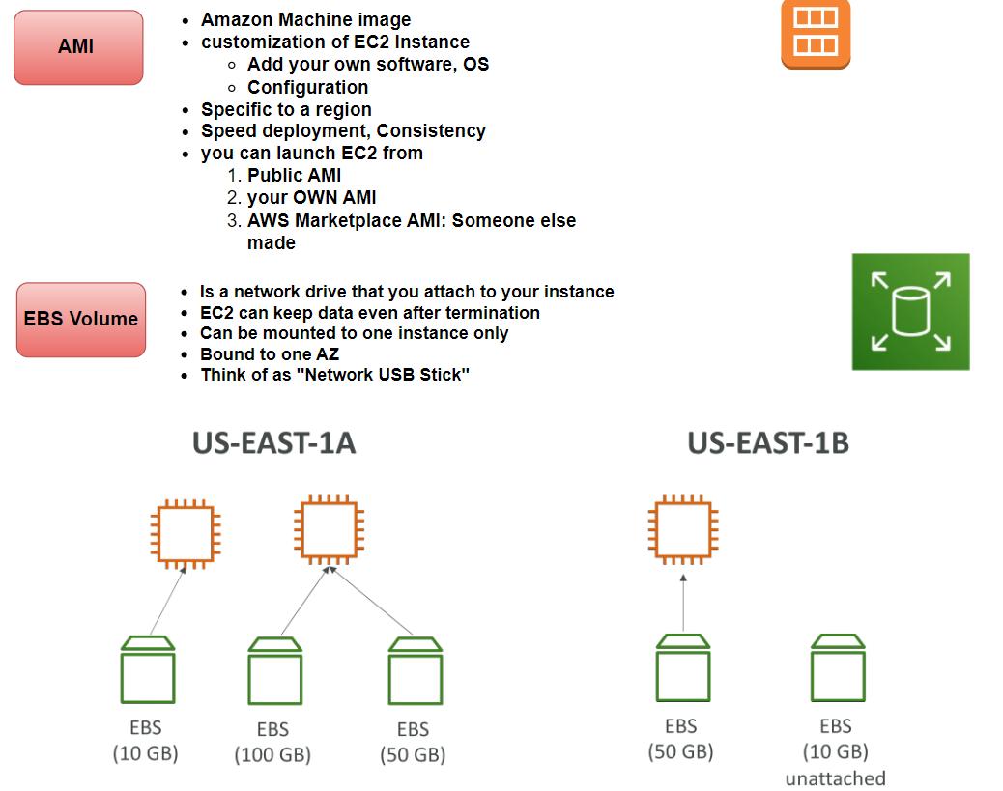

Slide 9
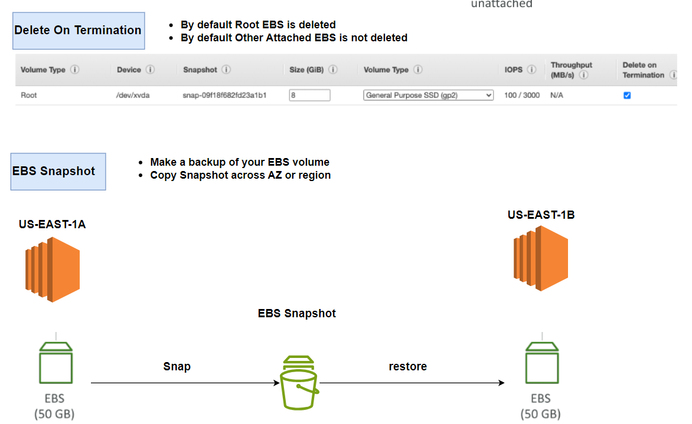

Slide 10
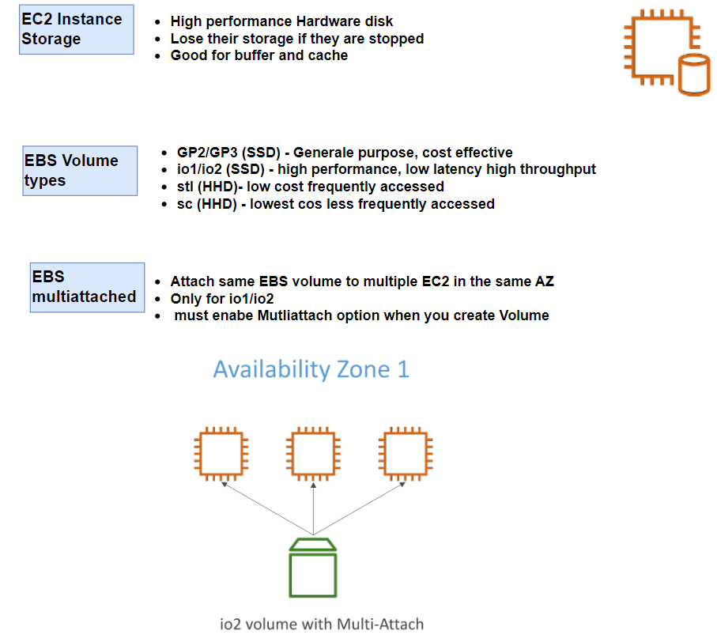

Slide 11
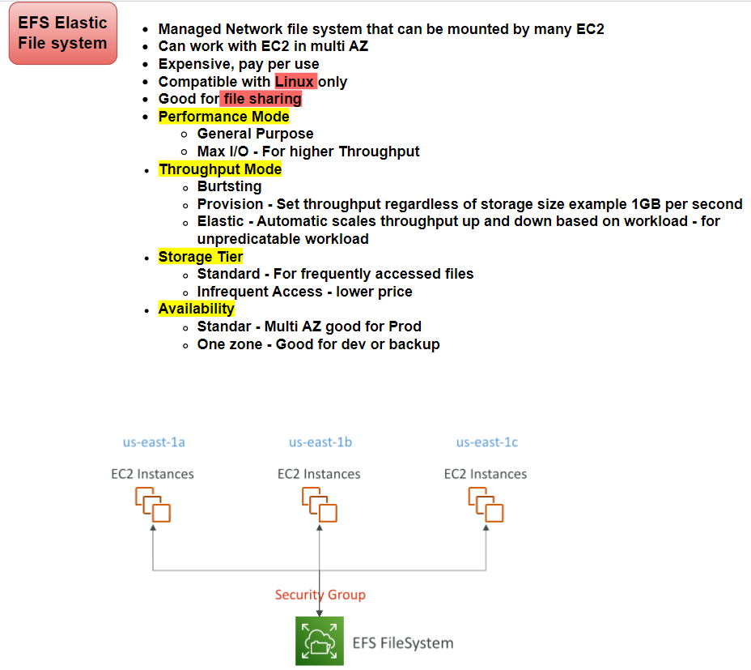

Slide 12
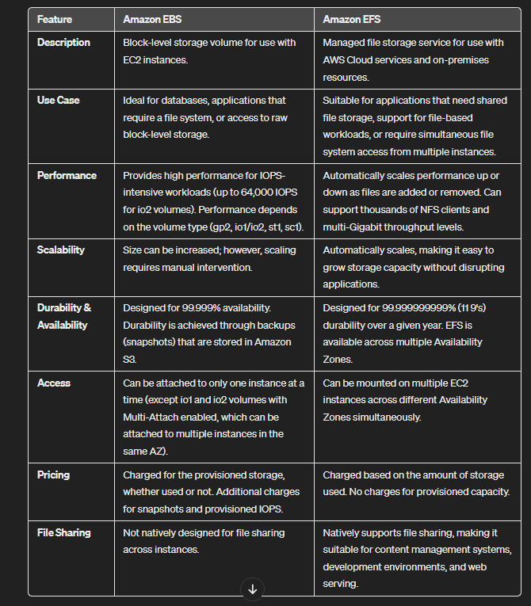

Slide 13
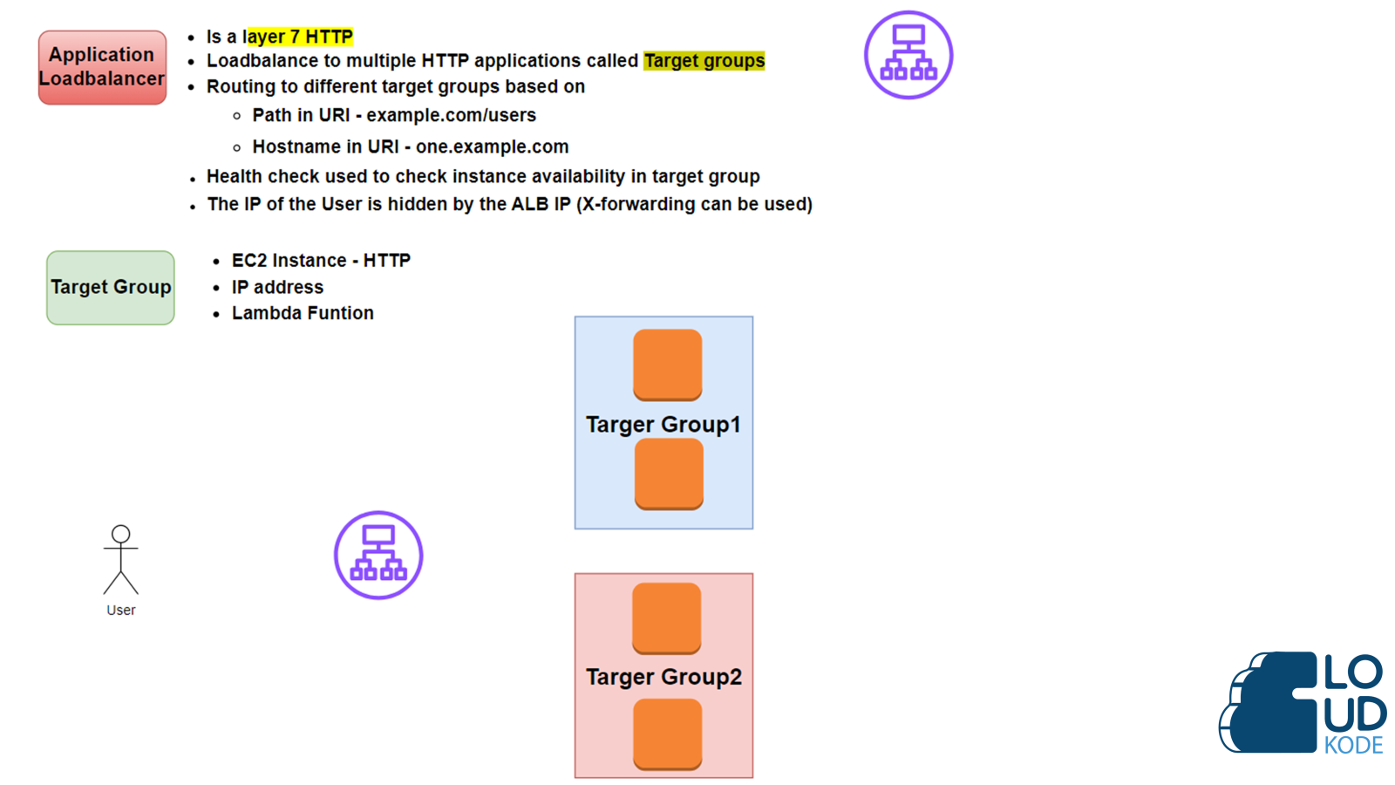

Slide 14
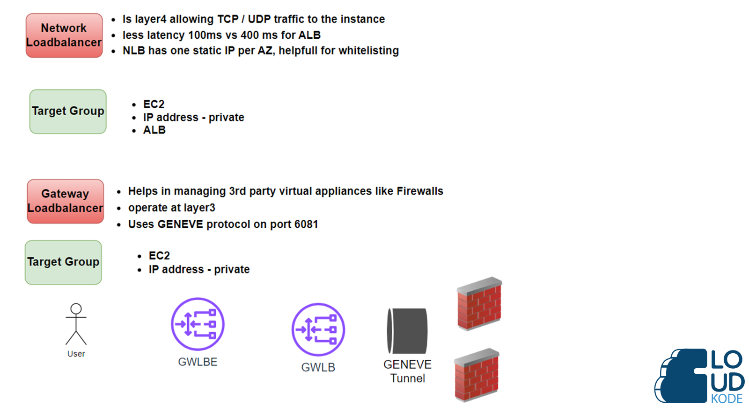

Slide 15
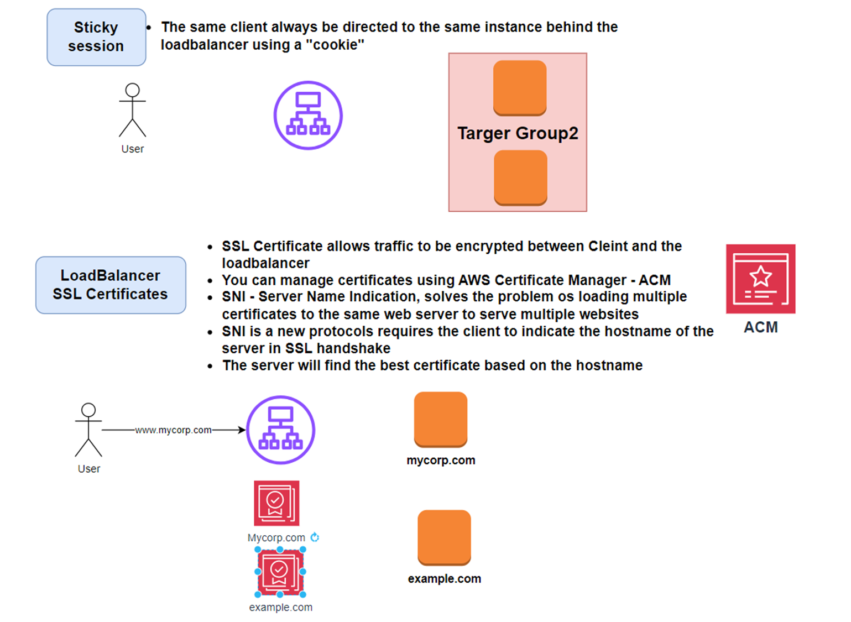

Slide 16
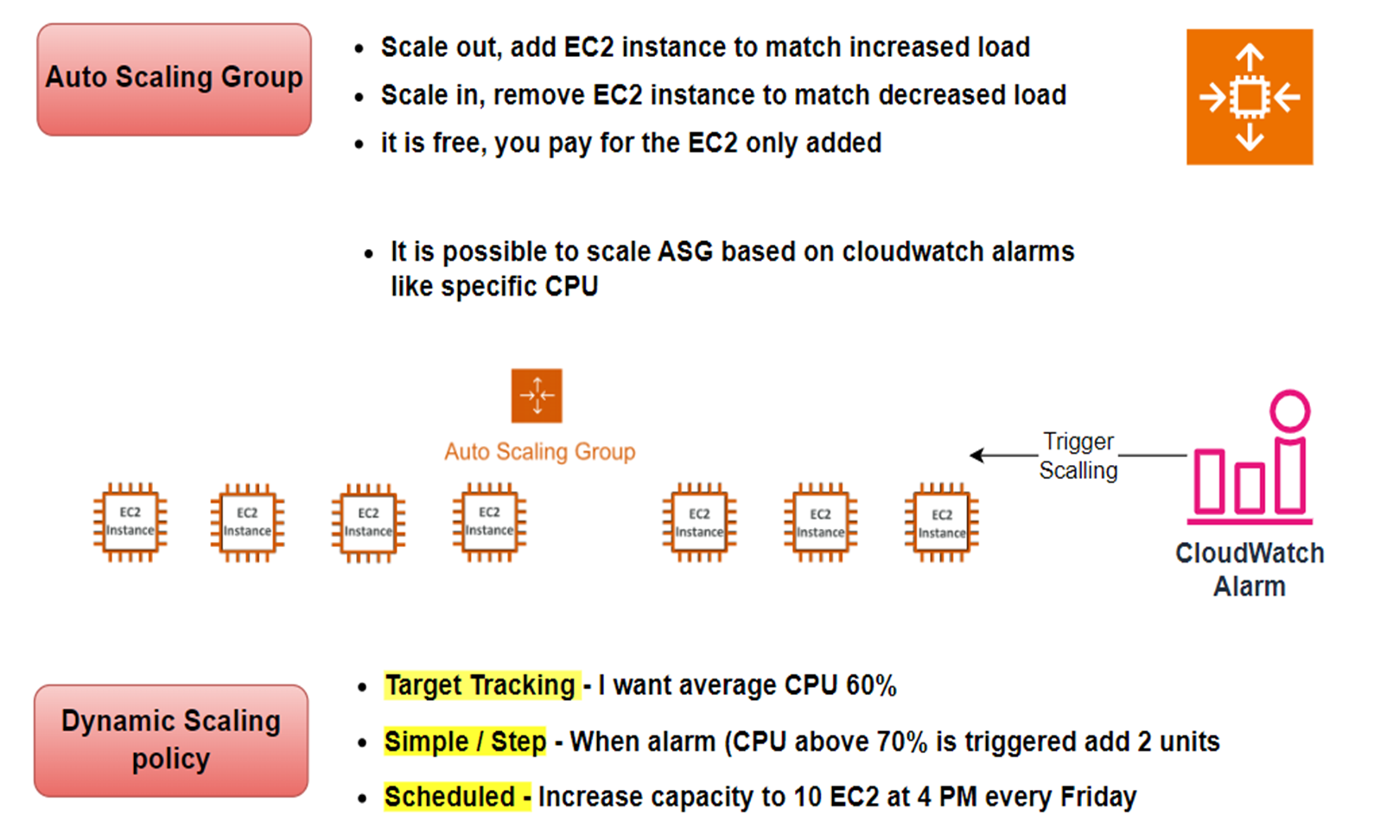

Slide 17
```
#!/bin/bash
# Update and install necessary packages
sudo apt-get update -y
sudo apt-get install -y apache2 unzip
# Fetching the token for IMDSv2
TOKEN=`curl -X PUT "http://169.254.169.254/latest/api/token" -H "X-aws-ec2-metadata-token-ttl-seconds: 21600"`
# Starting HTML file
echo '<html><center><body bgcolor="black" text="#39ff14" style="font-family: Arial"><h1>Load Balancer Demo</h1><h3>Availability Zone: ' > /var/www/html/index.html
# Using the token to fetch metadata
echo $(curl -H "X-aws-ec2-metadata-token: $TOKEN" http://169.254.169.254/latest/meta-data/placement/availability-zone) >> /var/www/html/index.html
echo '</h3> <h3>Instance Id: ' >> /var/www/html/index.html
echo $(curl -H "X-aws-ec2-metadata-token: $TOKEN" http://169.254.169.254/latest/meta-data/instance-id) >> /var/www/html/index.html
echo '</h3> <h3>Public IP: ' >> /var/www/html/index.html
echo $(curl -H "X-aws-ec2-metadata-token: $TOKEN" http://169.254.169.254/latest/meta-data/public-ipv4) >> /var/www/html/index.html
echo '</h3> <h3>Local IP: ' >> /var/www/html/index.html
echo $(curl -H "X-aws-ec2-metadata-token: $TOKEN" http://169.254.169.254/latest/meta-data/local-ipv4) >> /var/www/html/index.html
# Ending HTML file
echo '</h3></html> ' >> /var/www/html/index.html
# - Ensure the Apache2 service is enabled and started.
sudo systemctl enable apache2
sudo systemctl start apache2

Slide 18
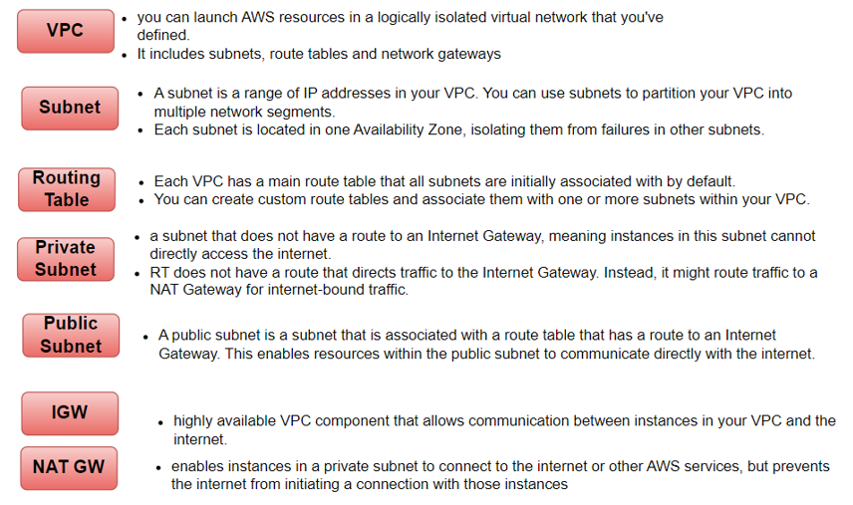

Slide 19
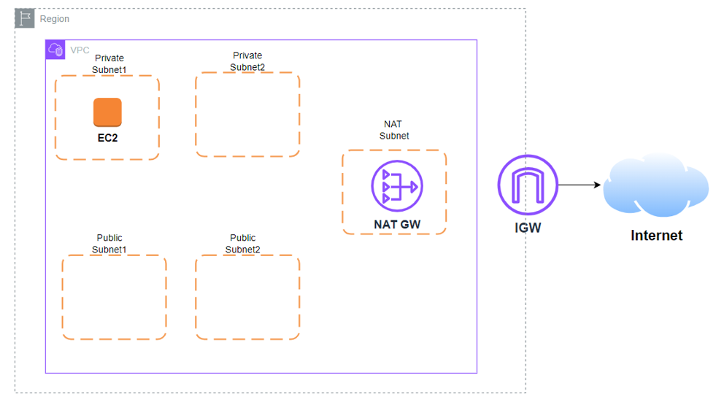

Slide 20
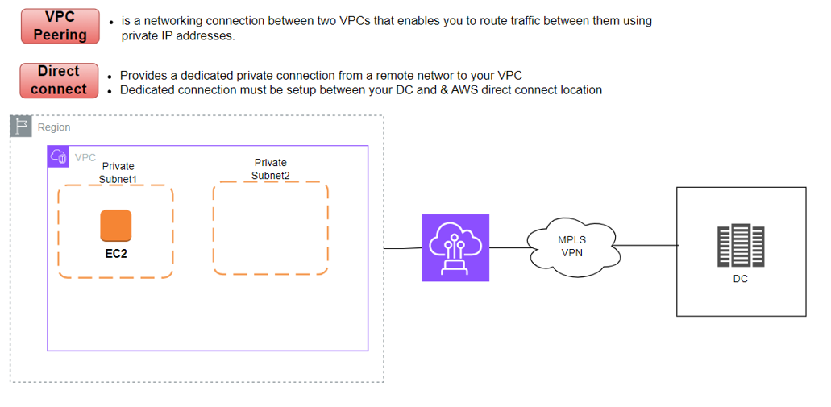

Slide 21
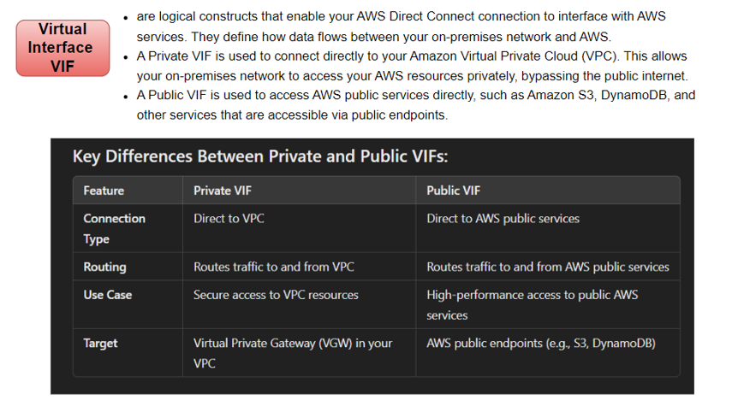

Slide 22
